Slide 1
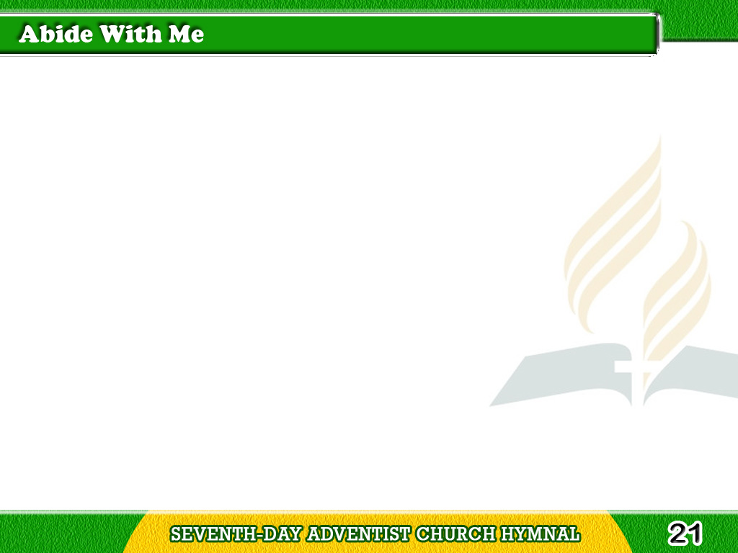

1/4
Abide with me;
fast falls the even tide;
The darkness deepens;
Lord with me abide;
Tagalog
Version

Slide 2
1/4
When other helpers fail
and comforts flee,
Help of the helpless,
O abide with me!
Tagalog
Version

Slide 3
2/4
Swift to its close ebbs
out life’s little day;
Earth’s joys grow dim,
its glories pass away;
Tagalog
Version

Slide 4
2/4
Change and decay
in all around I see;
O Thou, who changest not,
abide with me!
Tagalog
Version

Slide 5
3/4
I need Thy presence
every passing hour;
What but Thy grace can
foil the tempter’s power?
Tagalog
Version

Slide 6
3/4
Who like Thyself my
guide and stay can be?
Through cloud and sunshine,
O abide with me!
Tagalog
Version

Slide 7
4/4
I fear no foe, with
Thee at hand to bless;
Ills have no weight,
and tears no bitterness;
Tagalog
Version

Slide 8
4/4
Where is death’s sting?
where, grave, thy victory?
I triumph still if
Thou abide with me!
Tagalog
Version

